Slide 1

IS Target into SCADA and PMS market
General: IS International Services is utilizing past SCADA and PMS projects to leverage significant business in critical power applications
As the market for these type of system is wide ranging, IS will attempt to provide a wide range of solutions for all types and sizes of PMS and SCADA system.
Our target market is heavy commercial to industrial electrical systems to include the following specific applications; Hospitals, data centers, embassies, and Industrial manufacturing plant
Our approach to this market is “Build your own” system. We start with basic infrastructure and allow customers to add capabilities for their particular application.

Slide 2
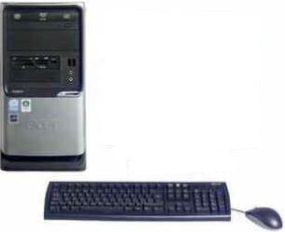

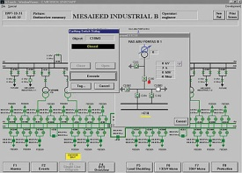




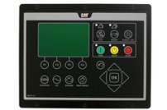

  Basic Infrastructure for SCADA and / or PMS Systems
Single or multiple Workstation(s) with SCADA Software
  WonderWare
  Rockwell Automation Factory Talk
  GE Proficy / iFix
  Siemens WinCC
Networking Equipment
Meters, Power Quality Meters
PQM
PQM
PQM
Protective Relays
Metering Relays
Metering Relays
PLCs, Generator Controllers

Slide 3
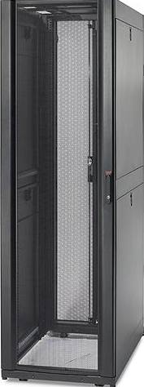

  Client / Server Infrastructure Based SCADA or PMS System
Client Workstations
Server
17” Flat Screen Monitor
Keyboard and Mouse
KVM Switch
HMI Network
Ethernet Switches
Engineering Workstation
HMI Server
Historian Server
Data Network
PQM
PQM
PQM
Metering Relays
Metering Relays
Critical Power System

Slide 4
  Client / Server Infrastructure Based SCADA or PMS System with Redundancy
Client Workstations
Server
17” Flat Screen Monitor
Keyboard and Mouse
KVM Switch
Engineering Workstation
Redundant Ethernet Switches
Redundant HMI Servers
Historian Server
Redundant
HMI Network
Redundant
Data Network
PQM
PQM
PQM
Metering Relays
Metering Relays
Critical Power System

Slide 5

  Client / Server Infrastructure Based SCADA or PMS System with Redundancy
  Utilizing Thin Client Architecture
Thin Client Workstations
Server
17” Flat Screen Monitor
Keyboard and Mouse
KVM Switch
Engineering Workstation
Redundant Ethernet Switches
Redundant HMI Servers
Historian Server
Redundant
HMI Network
Redundant
Data Network
PQM
PQM
PQM
Metering Relays
Metering Relays
Critical Power System

Slide 6



  Client / Server Infrastructure Based SCADA or PMS System with Redundancy
  Sample
Power Distribution System
Workstations
In addition to viewing SCADA screens, this architecture seamlessly allows monitoring and control of all power distribution workstations
SCADA
Server
Servers
Thin Client
Workstation
Thin Client
Workstation
Thin Client
Workstation
Thin Client
Workstation
RS View
Client
RS View
Client
RS View
Client
RS View
Client
RS View
Client
RS View
Client
RS View
Client
RS View
Client
BMS Server
Data Collection
Meters & Protective relays monitoring
Paralleling Switchgear monitoring
Low Voltage monitoring
Generator monitoring
Automated Web Page IP Tunneling
Reporting
Trending / Historian / Alarming
RS View
Client
RS View
Client
RS View
Client
RS View
Client
BMS Scope
Rockwell RS-View 32 Workstations
Rockwell Factory Talk 64-bit SCADA System

Slide 7
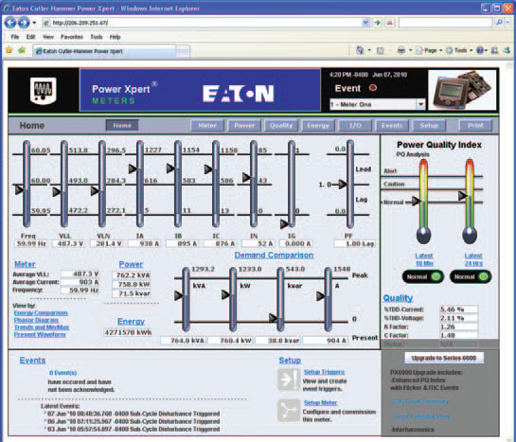
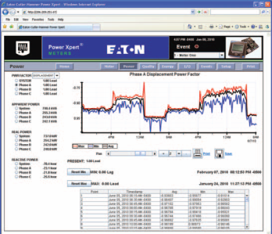
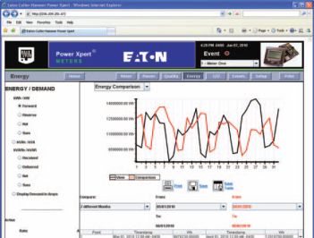
  Standard features for all Architectures:
  IP Tunnelling to Intelligent Electronic Devices (IEDs)
Dashboard
Server
Power Quality
Energy Comparison
PQM
PQM
PQM
Metering Relays
Metering Relays
Etc.

Slide 8
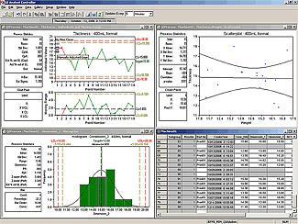
  Standard features for all Architectures:
  Alarming
Server
PQM
PQM
PQM
Metering Relays
Metering Relays

Slide 9
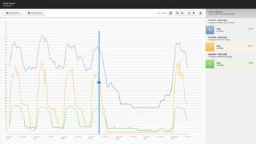
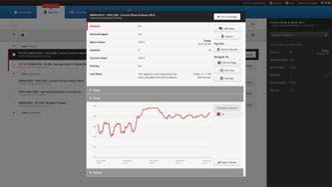
  Standard features for all Architectures:
  Reporting
Server
PQM
PQM
PQM
Metering Relays
Metering Relays

Slide 10
  Standard features for all Architectures:
  Historization
Server
PQM
PQM
PQM
Metering Relays
Metering Relays

Slide 11

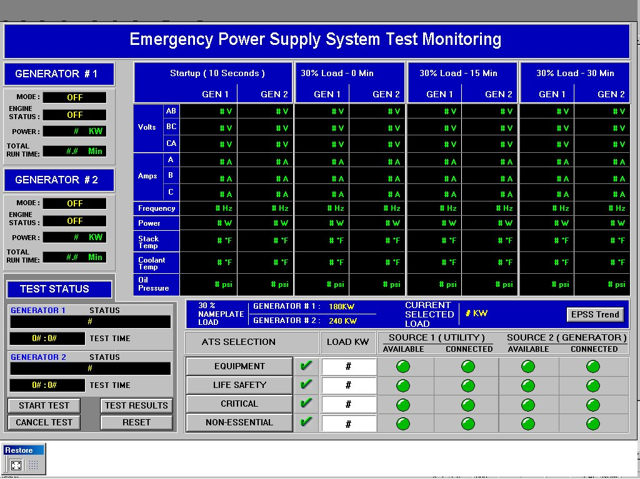
  Additional features that can be added to most of the architectures
  JHACO Reporting for EPSS Hospitals
Server
PQM
PQM
PQM
Metering Relays
Metering Relays

Slide 12

  Additional features that can be added to most of the architectures
  Remote Monitoring – Maintenance & Operations
Server
PQM
PQM
PQM
Metering Relays
Metering Relays

Slide 13

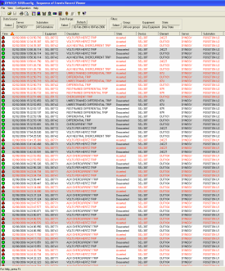
  Additional features that can be added to most of the architectures
  Sequence of Events Reporting
Server
PQM
PQM
PQM
Metering Relays
Metering Relays

Slide 14
  Additional features that can be added to most of the architectures
  Interface to “other” system e.g.; Building Management Systems
Modbus
Modbus TCP
BACNet
Others if required
Server
BMS
PQM
PQM
PQM
Metering Relays
Metering Relays

Slide 15
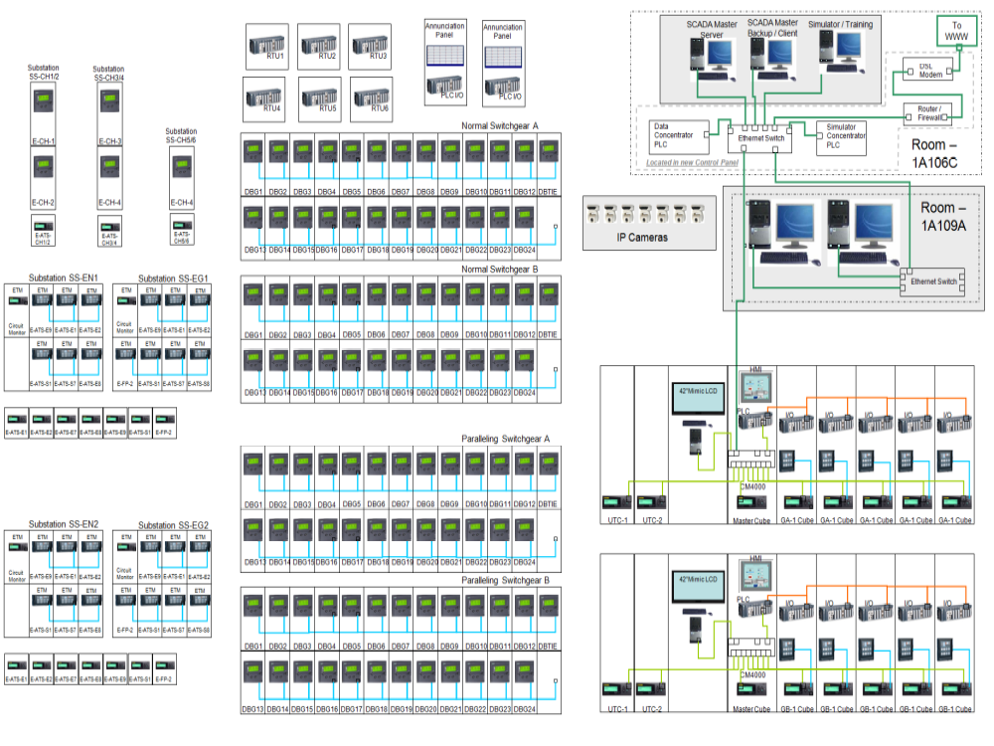
Sample of Muli-Vendor System

